Slide 1
AIML CA1
Emmett Chua P2222457 2A06

Slide 2
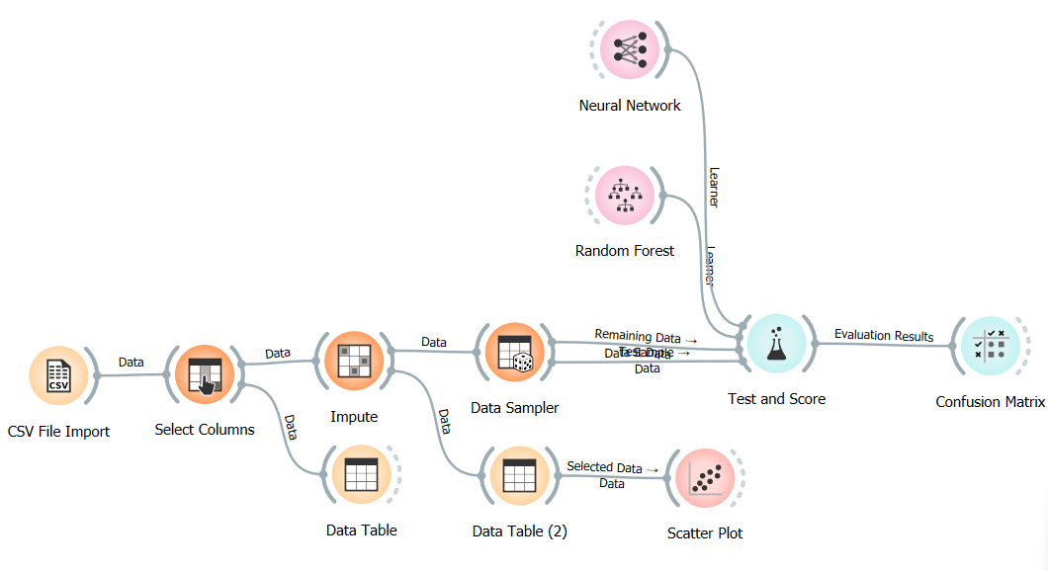

Slide 3
Using select columns to filter out which data I will be using
Dropped columns
Required columns
Pclass
Sex
Age
Fare
Embarked
Sibsp
Parch
Survived
Cabin
Ticket
These columns are more relevant towards the final outcome of whether the passenger has survived or not.
Survival is the target variable;
Pclass, sex, age are most likely to be looked at for consideration;
Fare, cabin and ticket indicates wealth between passengers and the likely hood of a safer location on the ship during the accident.
Sibsp and Parch could result in selflessness sacrifices from parents to children, siblings to siblings and between spouce.
Passenger ID
Name
The two columns are unique to each row. Due to each unique value, this may result in higher computational power ; hence, they are not included

Slide 4
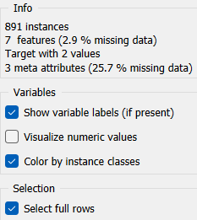
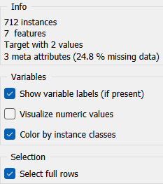

Slide 5
UNDERSTANDING OUR DATA
The scatterplot tells us that there is a significant number of people who paid lesser for their fare and they did not survive.
Those who had a higher Pclass were less likely to survive ; those who had a lower Pclass were more likely to survive
There is no awkward or oddly shaped patterns in the data visualization which tells us that there is no need for us to transform the data

Slide 6
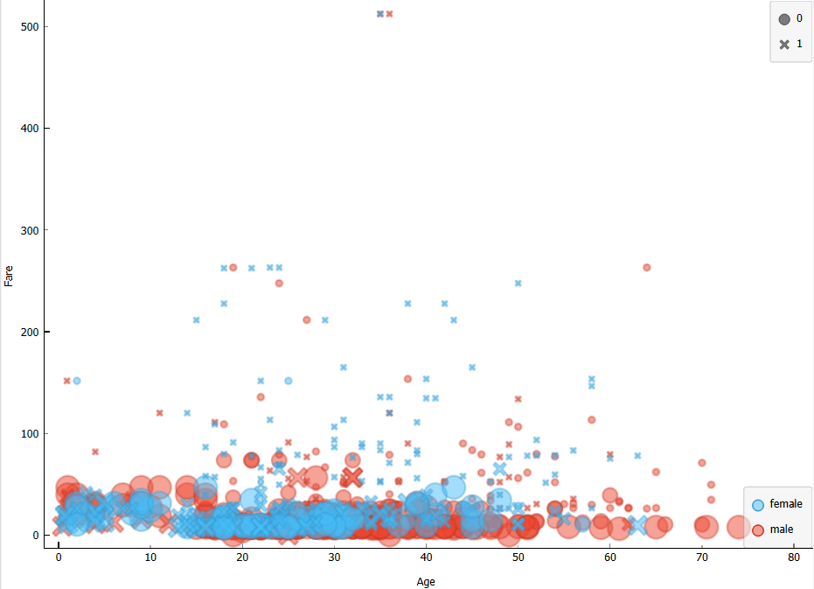
Axes
x-axis : Age
y-axis : Fare
Attributes
Color : Sex
Shape : Survived
Size : Pclass

Slide 7
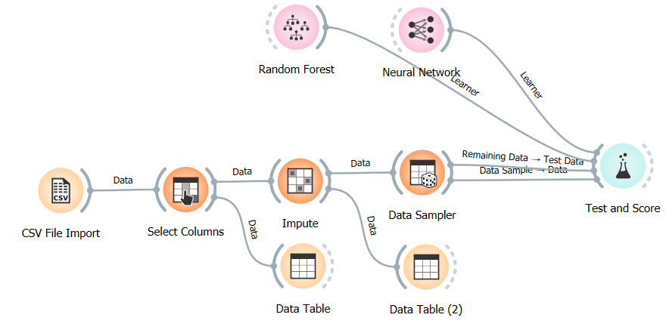

Slide 8
CLEAning THE DATA
Empty values
After consideration
Cabin
Age
It would not make sense to use the Average/Most Frequent data to replace the empty data. Variables like age and cabin cannot be predicted in any way and hence have to be dropped
Replacing empty data with Average/Most Frequent data was what I first thought of.

Slide 9
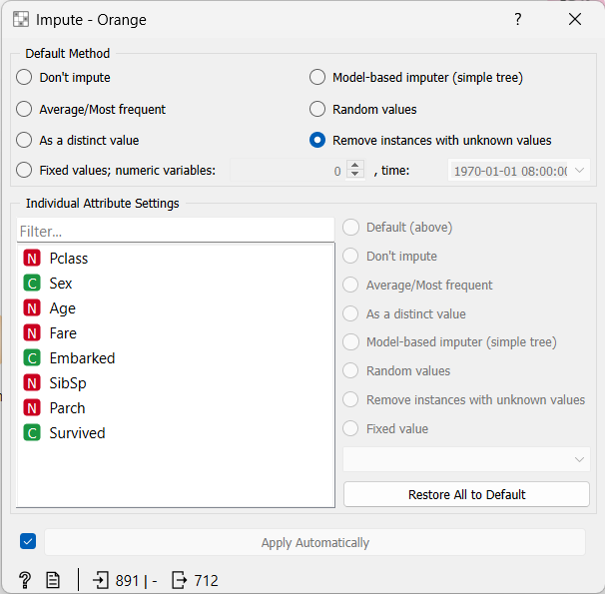

Slide 10
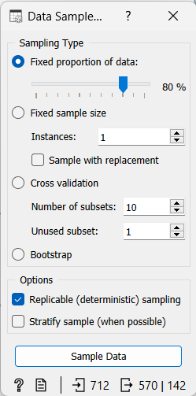
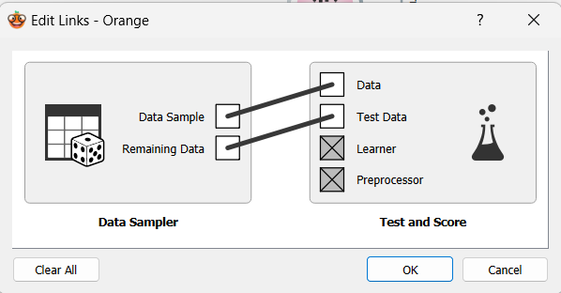
Data sampling

Slide 11
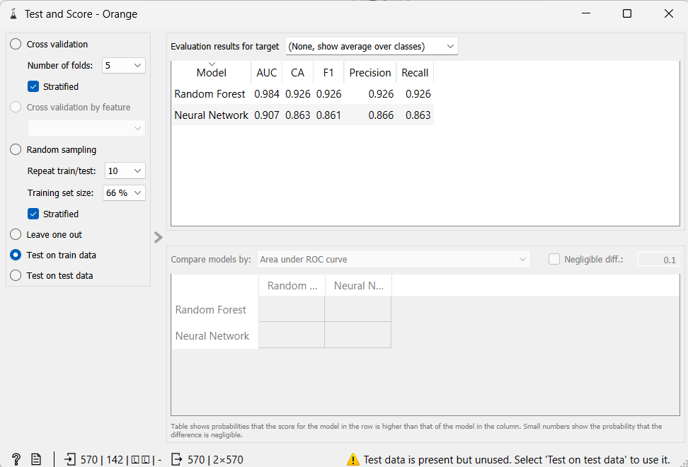
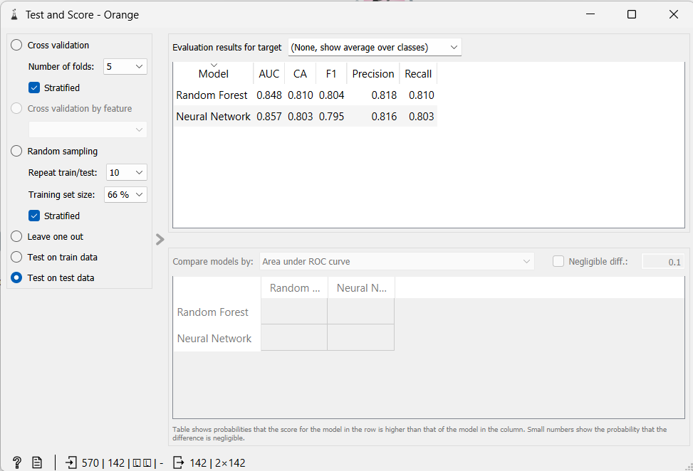
Training the model
First training
First test
Notes:
I have chosen random forest and neural networks.
Random forest builds decision trees based on different samples and takes the scenario for which passenger survives.
Neural networks works similarly but processes the data more like how humans do.

Slide 12

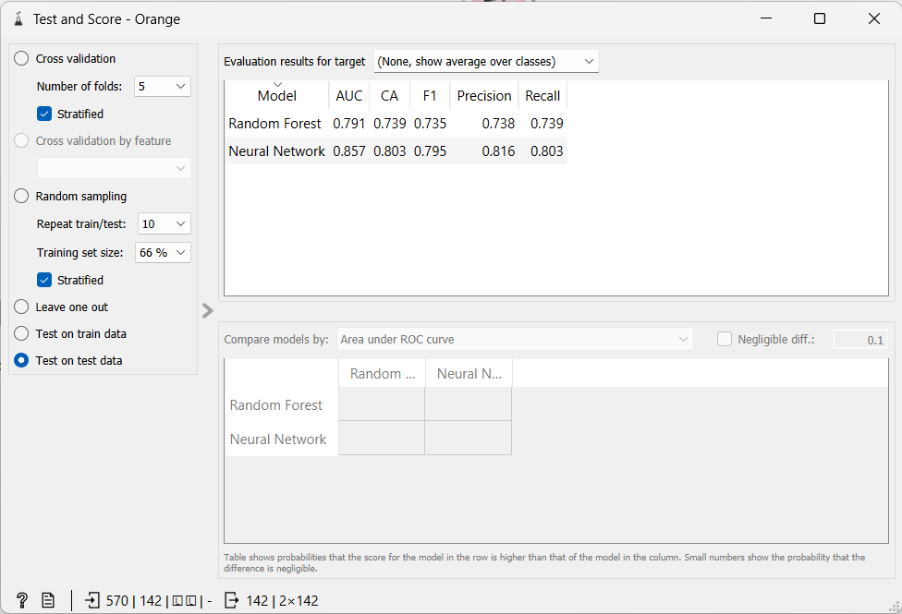
Training the model
Second training
Second test
Notes:
I have chosen random forest and neural networks.
Random forest builds decision trees based on different samples and takes the scenario for which passenger survives.
Neural networks works similarly but processes the data more like how humans do.

Slide 13
THANK YOU

